Slide 1
PROJECT TITLE : CODING LANGUAGE FLASHCARDS APP
GUIDED BY:
MS SWAPNA B SASI
GROUP NO:3 MEMBERS
JEC21CS010 - ADITYA MANOJ A JEC21CS015 - ALEENA KURUVILA JEC21CS017 - ALFIN JOSE

Slide 2
DEPARTMENT OF COMPUTER SCIENCE & ENGINEERING
Vision of the Department
Creating eminent and ethical leaders in the domain of Computational Sciences through quality professional education
with a focus on holistic learning and excellence.
Mission of the Department
To create technically competent and ethically conscious graduates in the field of Computer Science and Engineering by encouraging holistic learning and excellence.
To prepare students for careers in Industry, Academia and the Government.
To instill Entrepreneurial Orientation and research motivation among the students of the department.
To emerge as a leader in education in the region by encouraging teaching, learning, industry and societal connect.

Slide 3
Programme Educational Objectives (PEOs)
The graduates shall have sound knowledge of Mathematics, Science, Engineering and Management to be able to offer practical software and hardware solutions for the problems of industry and society at large.
The graduates shall be able to establish themselves as practicing professionals, researchers or Entrepreneurs in computer science or allied areas and shall also be
able to pursue higher education in reputed institutes.
The graduates shall be able to communicate effectively and work in multidisciplinary teams with team spirit demonstrating value driven and ethical leadership.

Slide 4
Programme Outcomes
Engineering Graduates will be able to:
Engineering knowledge: Apply the knowledge of mathematics, science, engineering fundamentals, and an engineering specialization to the solution of complex engineering problems.
Problem analysis: Identify, formulate, review research literature, and analyze complex engineering
problems reaching substantiated conclusions using first principles of mathematics, natural sciences, and engineering sciences.
Design/development of solutions: Design solutions for complex engineering problems and design
system components or processes that meet the specified needs with appropriate consideration for
the public health and safety, and the cultural, societal, and environmental considerations.
Conduct investigations of complex problems: Use research-based knowledge and research methods including design of experiments, analysis and interpretation of data, and synthesis of the
information to provide valid conclusions.
Modern tool usage: Create, select, and apply appropriate techniques, resources, and modern
engineering and IT tools including prediction and modeling to complex engineering activities with an understanding of the limitations.

Slide 5
The engineer and society: Apply reasoning informed by the contextual knowledge to assess societal, health, safety, legal and cultural issues and the consequent responsibilities relevant to the professional engineering practice.
Environment and sustainability: Understand the impact of the professional engineering solutions in societal and
environmental contexts, and demonstrate the knowledge of, and need for sustainable development.
Ethics: Apply ethical principles and commit to professional ethics and responsibilities and norms of the engineering practice.
Individual and team work: Function effectively as an individual, and as a member or leader in diverse teams,
and in multidisciplinary settings.
10 Communication: Communicate effectively on complex engineering activities with the engineering community
and with society at large, such as, being able to comprehend and write effective reports and design documentation, make effective presentations, and give and receive clear instructions.
11. Project management and finance: Demonstrate knowledge and understanding of the engineering and
management principles and apply these to one’s own work, as a member and leader in a team, to manage projects and in multidisciplinary environments. 12. Life-long learning: Recognize the need for, and have the preparation and ability to engage in independent and life-long learning in the broadest context of technological change.

Slide 6

Programme Specific Outcomes (PSOs)
On the completion of Computer Science & Engineering program, the students will possess:
An ability to apply knowledge of data structures and algorithms appropriate to computational problems.
An ability to apply knowledge of operating systems, programming languages, data management, or networking principles to computational assignments.
An ability to apply design, development, maintenance or evaluation of software engineering principles in
the construction of computer and software systems of varying complexity and quality.
An ability to understand concepts involved in modeling and design of computer science applications in a
way that demonstrates comprehension of the fundamentals and trade-offs involved in design choices

Slide 7
CONTENTS
Introduction
Objective of the project
Problem Identification
Literature Review
Proposed System
SRS Document
Lifecycle To Be Followed
Architectural Diagram
Data Flow Diagram (level 0,1,2)
ER Diagram
Implementation Details
Conclusion & Future Enhancements
References

Slide 8


INTRODUCTION
1. Challenges: Educators struggle to create engaging online language learning experiences, hindering fluency due to a lack of collaboration.
2.Objective: Our research aims to enhance interaction and collaboration among learners by providing strategies
and developing a platform.
3.Features:
Authentication: Secure login.
Language Selection: Choice of learning language.
Progress Tracking: Personalized feedback.
Quiz Mode: Interactive assessment
AI chat bot : Live Interaction with bot.
Blog Page:users can share their views.
Code enhancer:improve code correctness
4.Impact: Implementing these strategies and features will significantly improve the online language learning
experience, aiding fluency attainment.

Slide 9
OBJECTIVES
Optimize Learning Design
Develop strategies for superior online language learning.
Enhance design to maximize online advantages for improved outcomes.
Integrate Tech Innovations
Seamlessly incorporate best tech for a dynamic learning experience.
Engage learners with diverse preferences using innovative tools.
Nurture educational growth
Address limited interaction in online language learning.
Provide practical solutions for active learner engagement and collaboration.
Contribute to Education Evolution
Significantly contribute to the evolution of online education.
Offer practical strategies to enhance collaboration

Slide 10
PROBLEM IDENTIFICATION
Maximizing online learning advantages involves effectively designing courses, integrating innovative technology, addressing interaction support deficiencies, particularly urgent in language learning, with ongoing research contributing to practical solutions for educators and institutions.

Slide 11
LITERATURE REVIEW
NO | PAPER TYPE | PUBLISHER | YEAR | TITLE | AUTHOR | INFERENCE
1 | IEEE | School of Languages and Linguistics Griffith University | 2014 | Learning design for online language learning: A systems design framework | Yuping Wang | Challenges facing online educators include maximizing the advantages of online learning, supporting interaction and collaboration, and leveraging innovative technology.

Slide 12
LITERATURE REVIEW
NO | PAPER TYPE | PUBLISHER | YEAR | TITLE | AUTHOR | INFERENCE
2 | Journal1 | International Journal for Research in Applied Science & Engineering Technology (IJRASET) | 2018 | A Review on Firebase (Backend as A Service) for Mobile Application Development | 1Prachi R. Saraf, Sakshi M. Jadhao, Saurabh J. Wanjari, Shital G. Kolwate,Pr of. Ankush D. Patil | In the era of rapid prototyping, ideas can be generated quickly, but their applicability can be limited if they require too much effort to implement, especially due to constraints in backend development

Slide 13
LITERATURE REVIEW
NO | PAPER TYPE | PUBLISHER | YEAR | TITLE | AUTHOR | INFERENCE
3 | Survey | Department of Computer Science and Engineering, Sri Manakula Vinayagar Engineering College, Puducherry, India | 2022 | Survey on Chatbots Using Artificial Intelligence | Mr. M. Ganesan Deepika.C Harievashin i.B Krithikha.A. S Lokhratcha na.B | The paper discusses the role of artificial intelligence (AI) and natural language processing (NLP) in the development of chatbots. It highlights the importance of chatbots in various fields, including communication, knowledge seeking, and entertainment.

Slide 14
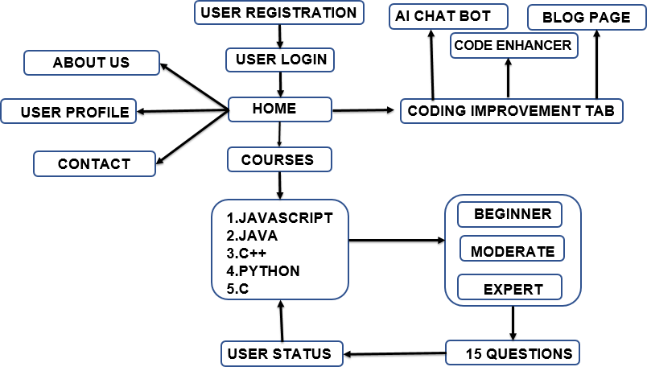
PROPOSED SYSTEM

Slide 15
PROPOSED SYSTEM
User Authentication and Profile Creation:
Users will register or log in to the app to access its features.
Upon registration, users can set their preferences, including their preferred coding languages and their proficiency levels.
Language Selection:
Provide a list of supported programming languages for users to choose from. Allow users to select one or more languages they want to learn or practice.
User Progress Tracking:
Develop a tracking system to record user activities, such as cards viewed, correct responses, and
time spent.
Quiz Mode:
Implement a quiz mode where users can test their knowledge by answering random flashcards Provide instant feedback on the correctness of answers and keep track of quiz scores.

Slide 16
PROPOSED SYSTEM
AI chat Bot:The system shall include an AI chatbot feature to assist users.Users shall be able to ask the chatbot questions related to language learning.The chatbot shall provide accurate and relevant responses using natural language understanding techniques
Blog Page: The system shall include a blog page where users can share their thoughts and knowledge.The blog page shall support comments and discussions on individual posts
Code Enhancer:The sytem shall include a code enhancer where users can enhances their code.Here users codes can be improved efficiently.This code enhancer also helps us to fix bugs in the code

Slide 17
SRS (SOFTWARE REQUIREMENT SPECIFICATION)
The requirements for the proposed coding language app can be classified into hardware and software requirements,functional and nonfunctional requirements.
Hardware Requirements (minimum)
Intel i3
Software Requirements
React Js
Firebase
Vs Code

Slide 18
SRS DOCUMENT(Function Requirements)
User Authentication and Profile Creation:
Users shall be able to register for an account using their email and password. Users shall be able to log in using their credentials.
Upon registration, users shall be prompted to create a profile, specifying their preferred coding languages and
proficiency levels
Language Selection:
The system shall provide a list of supported programming languages.
Users shall be able to select one or more languages they want to learn or practice from the provided list.
User Progress Tracking:
The system shall track user activities, including cards viewed, correct responses, time spent, and quiz scores. Users shall be able to view their progress in learning each programming language.

Slide 19
SRSDOCUMENT(FunctionRequirement)
Quiz Mode:
Users can test knowledge with random flashcards.
Instant feedback on correctness of answers.
AI Chatbot:
AI chatbot assists users with language learning queries.
Users ask language-related questions.
Chatbot provides accurate responses using natural language understanding.
Blog Page:
Users access educational articles, tips, and resources.
Browse, search, and filter blog posts by topic.
Supports comments and discussions on posts.
Code Enhancer:
Users can enhances their code.
Users can efficiently improve theyir codes by giving to it.
Fix the bugs and errors in the code neatly

Slide 20
SRS DOCUMENT(Non-Function Requirements)
Performance:
System response time: <2 seconds. Chatbot response time: <5 seconds.
Blog page loading time: <3 seconds, even with large content.
Support up to 1000 simultaneous users without performance degradation.
Security:
Encryption for user authentication and data transmission. Secure storage of user passwords using hashing algorithms. Secure encryption for user interactions with the chatbot.
Moderation of user comments on the blog page to prevent spam and inappropriate content.
Usability:
Intuitive and easy-to-navigate user interface.
Clear instructions for interaction with the chatbot interface.
Accessibility across multiple devices: desktops, tablets, and smartphones.

Slide 21
SRS DOCUMENT(Non-Function Requirements)
Reliability:
System uptime: ≥99.9%.
Chatbot fallback mechanism in case of failure.
Regular updates on the blog page to maintain user engagement. Regular backup of user data to prevent loss.
Scalability:
System architecture designed for future scalability.
Ability to handle increased users and data without major modifications.
Chatbot capable of managing growing user queries without performance issues.
Blog page supports growing content and user comments without performance degradation.

Slide 22
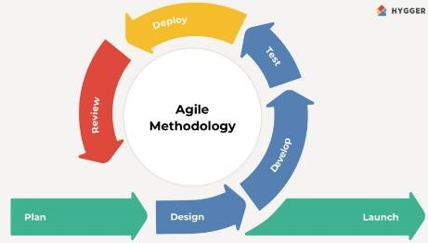
LIFE CYCLE TO BE FOLLOWED

Slide 23
LIFE CYCLE TO BE FOLLOWED
Agile follows iterative development enabling the coding language flashcard app to evolve gradually and by breaking down development into smaller manageable iteration,agile helps mitigate risks associated with building complex system like coding language app.
Agile methodologies encourage community collaboration and contributions to the app's content and features.In the app there is separate blog page where users can contribute their knowledge to other users and development team.
Agile enables quick response to changing preferences ,as we know new coding languages are developing day by day so regular updates are needed in the coding app questions and technological advancements like AI chatboat are brought into the app.
Agile methodologies facilitate the integration of gamification elements into the app, such as scores,
achievements, leaderboards, and progress users can select the difficulty level of questions in the app.
By harnessing the power of Agile methodology, developers can create app that is dynamic, adaptive, and effective in empowering learners to master programming languages.

Slide 24
ARCHITECTURE DIAGRAM

Slide 25
MODULE | EXPLANATION
User | Registration Allows new users to create an account. Captures user details and credentials for authentication. Typically includes fields like username, email, and password. login Enables registered users to log in to their accounts. Grants access to personalized features.

Slide 26
MODULE
EXPLANATION
AI chat bot
Coding improvement tab
main part of the project
Carried out AI chat intetaction
users can nullify their doubts and build their
programming doubts.
Blog page
Users can post questions and other users can answer to them in the comments making an interactive panel and more active learning.
Code Enhancer
Main part of the project where users can enhances their code,imrove efficiency of the cde and fix errors init and all

Slide 27
MODULE | EXPLANATION
Quiz tab | Courses • provides different programming languages. • provides languages like javascript, java, c, python,c++ Difficulty selection users can select the difficulty of the quiz provides mainly three modes.

Slide 28
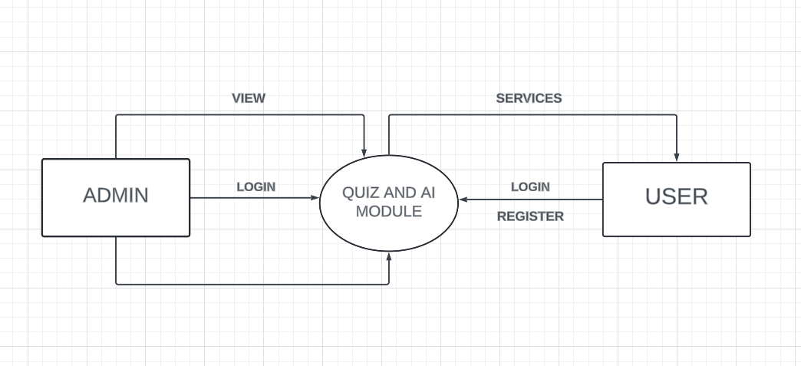
DATA FLOW DIAGRAM(LEVEL0)

Slide 29
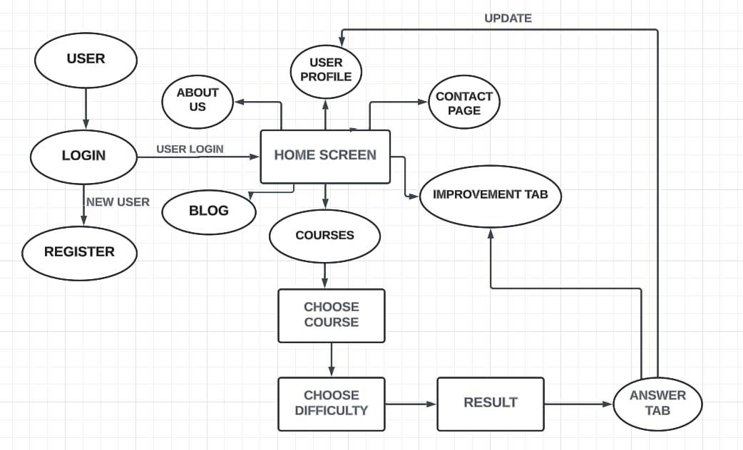
DATA FLOW DIAGRAM(LEVEL 1)

Slide 30
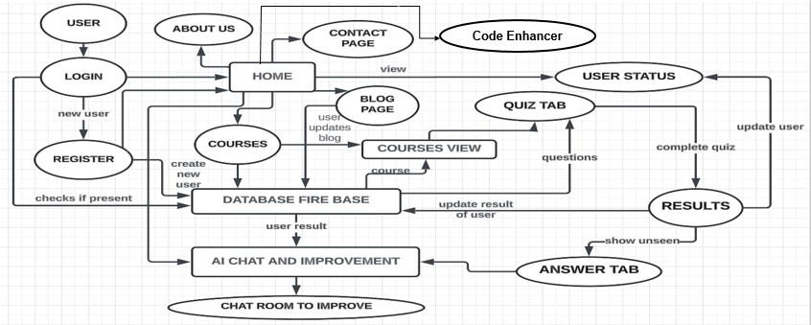
DATA FLOW DIAGRAM(LEVEL 2)

Slide 31


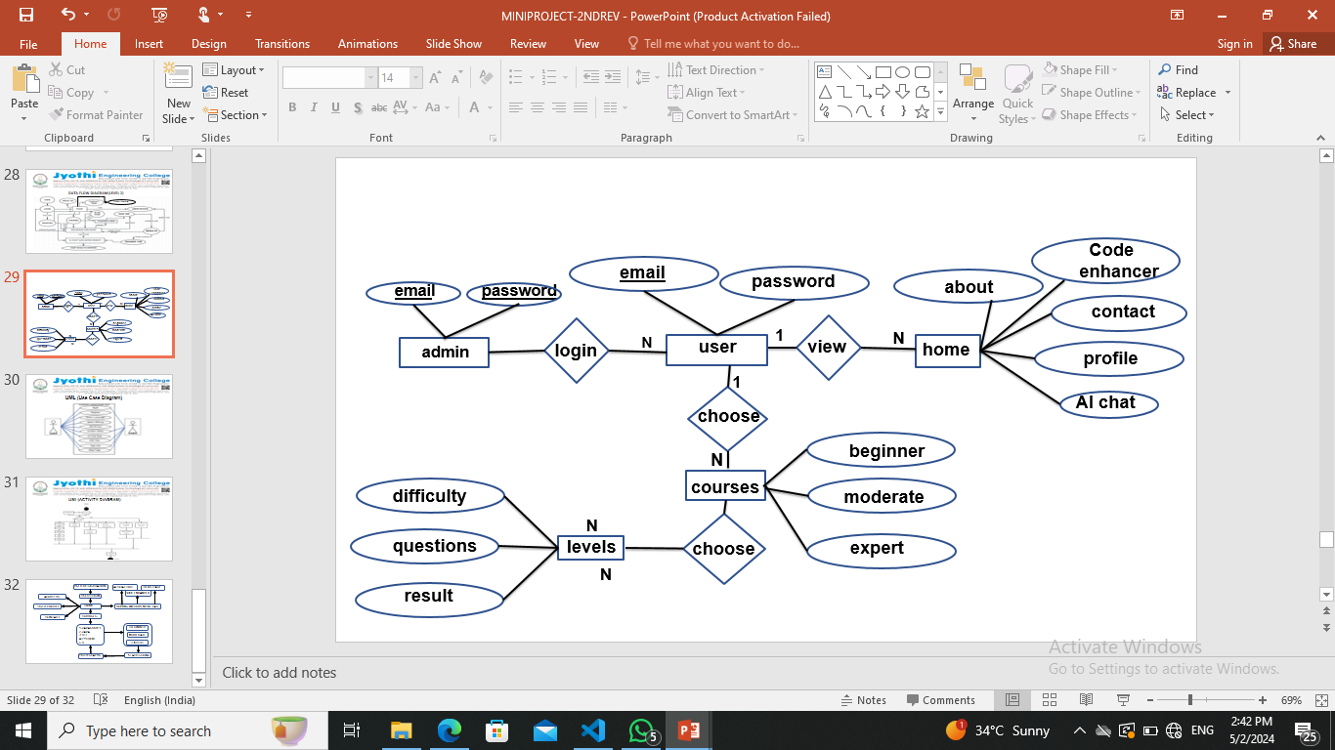
ER DIAGRAM

Slide 32
IMPLEMENTATION DETAILS

Slide 33
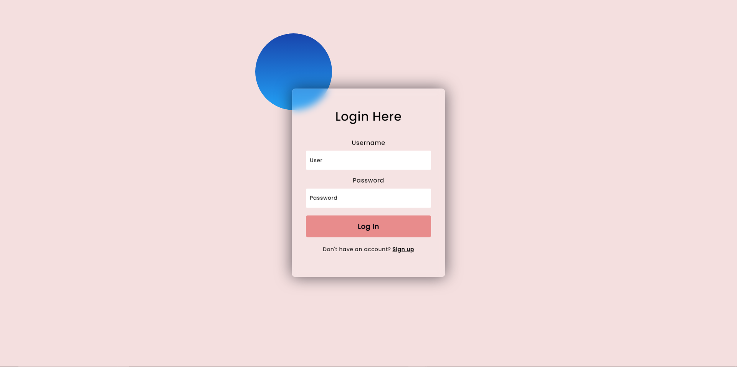

Slide 34
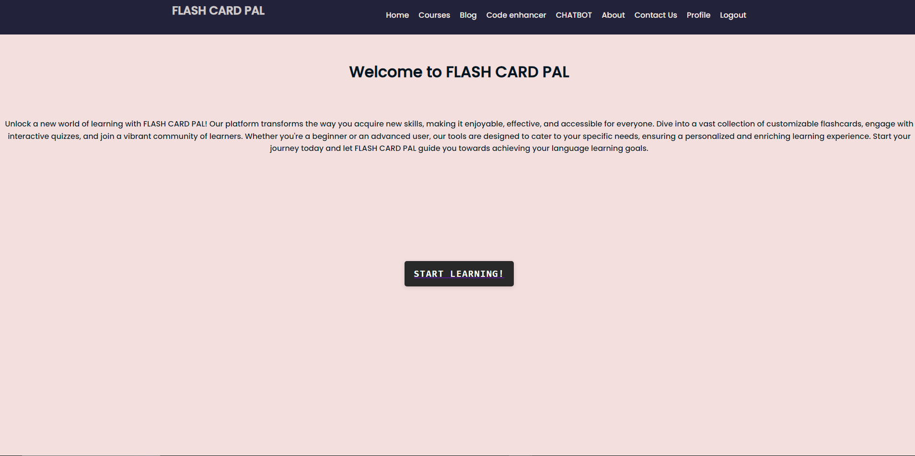

Slide 35
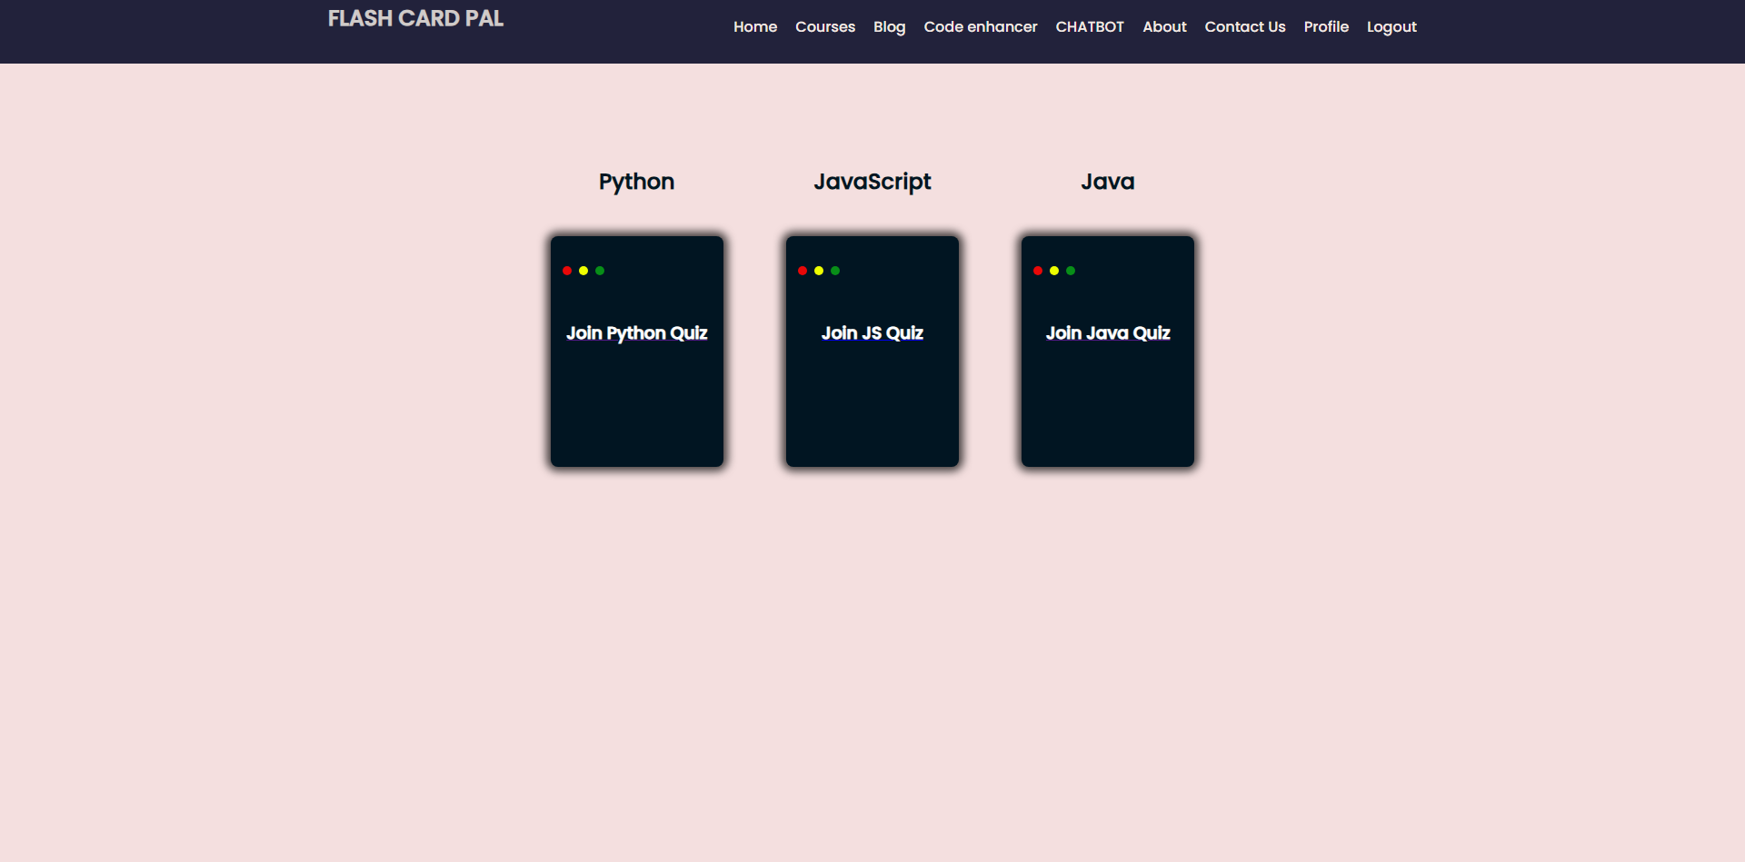

Slide 36
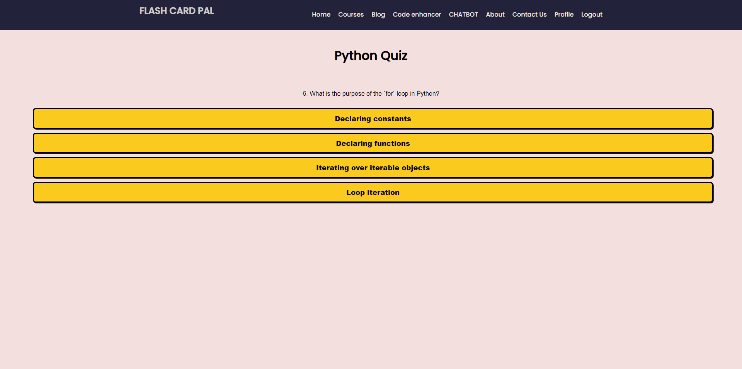

Slide 37
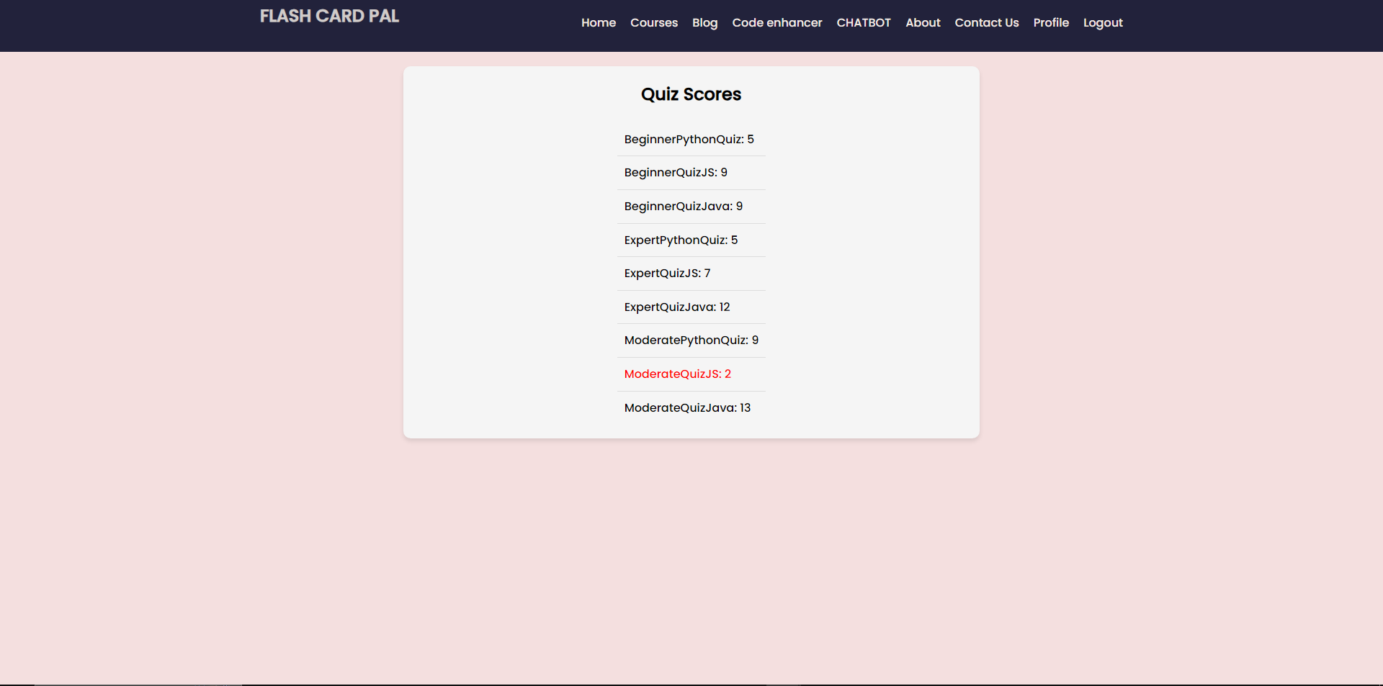

Slide 38
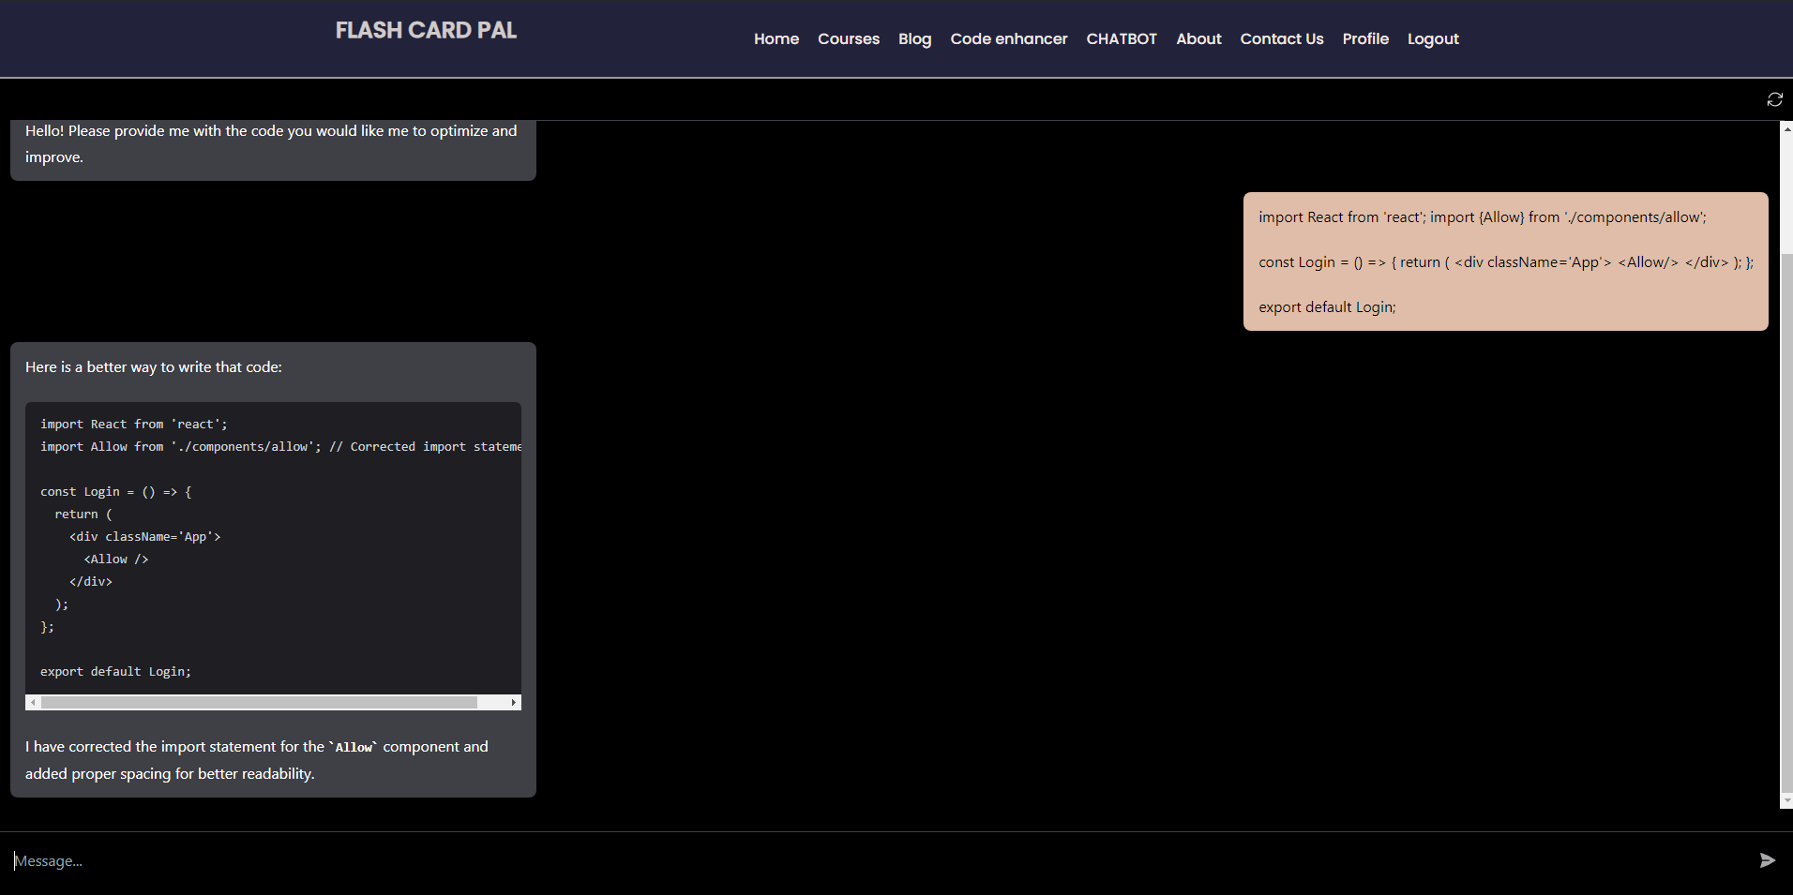

Slide 39
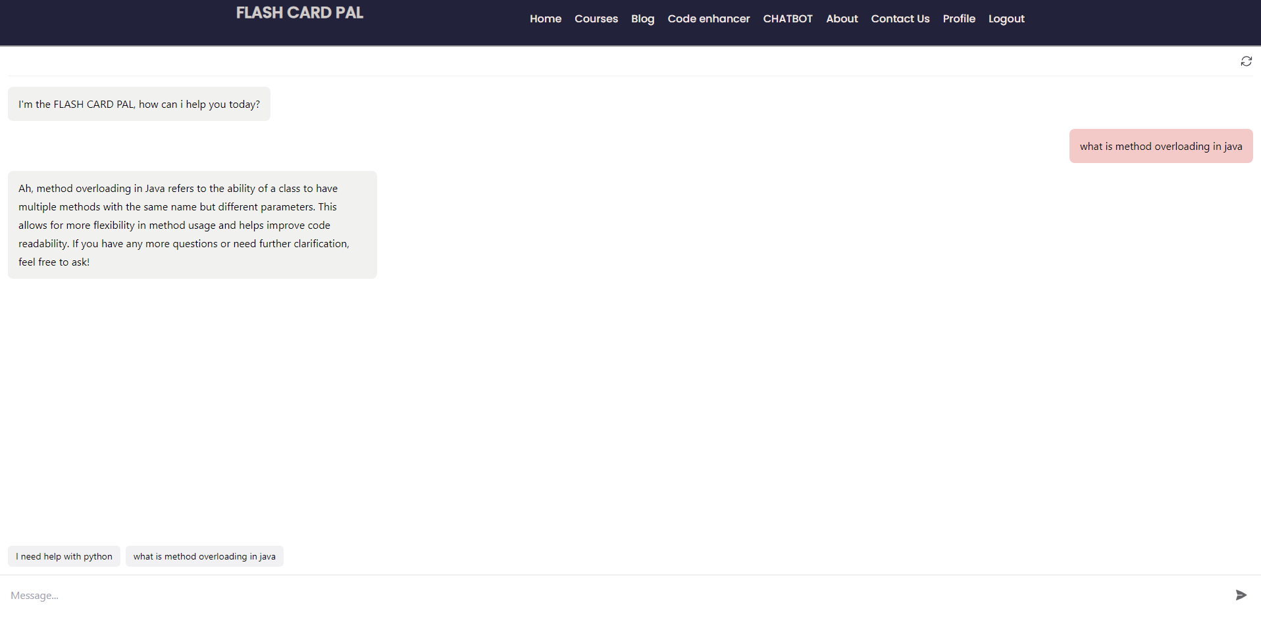

Slide 40
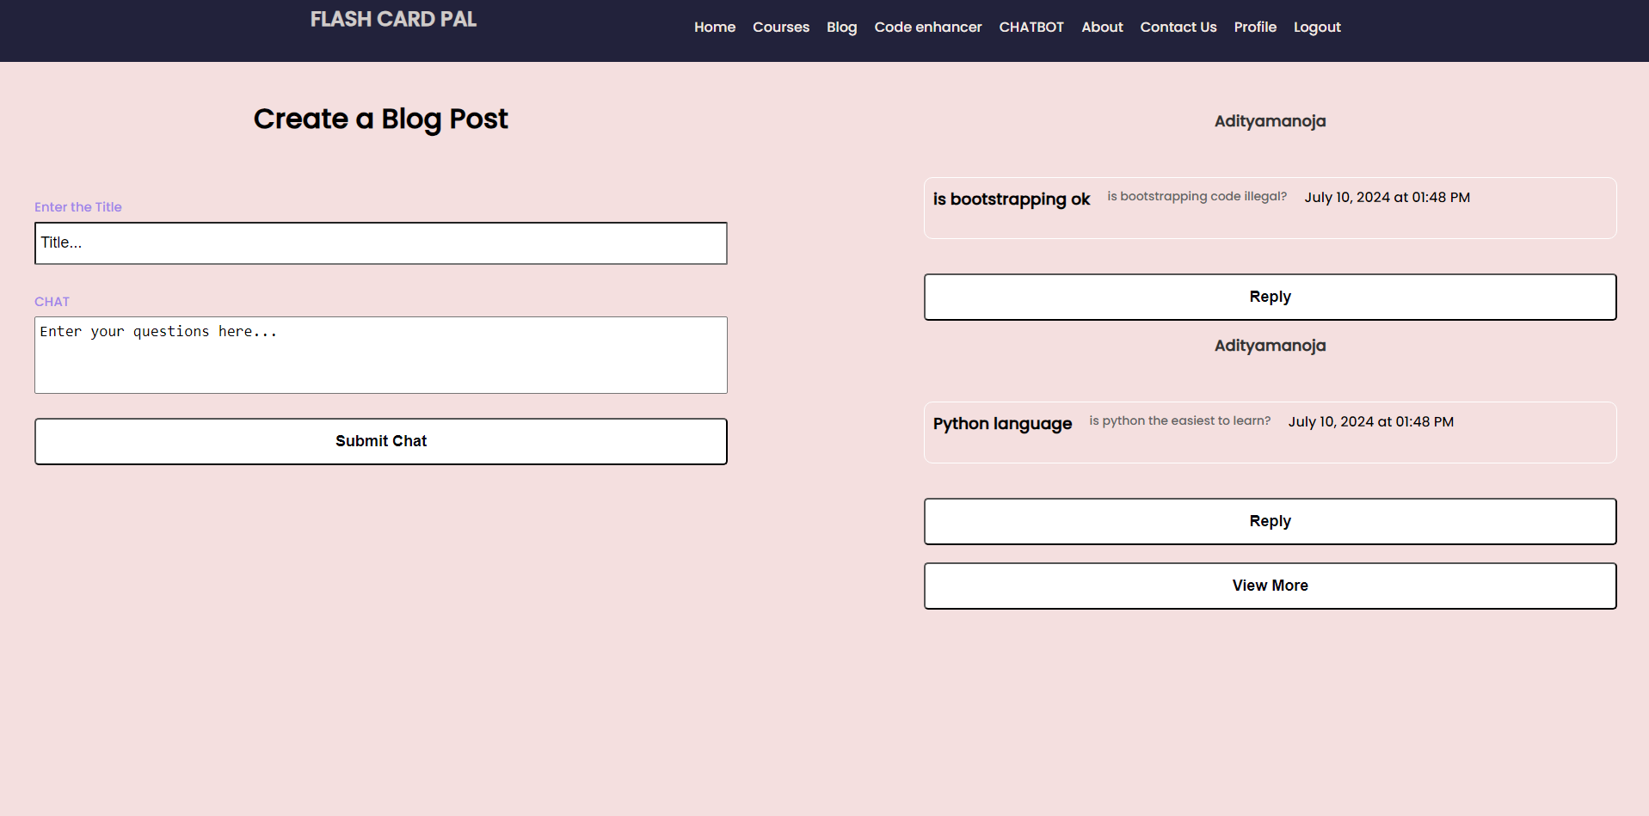

Slide 41
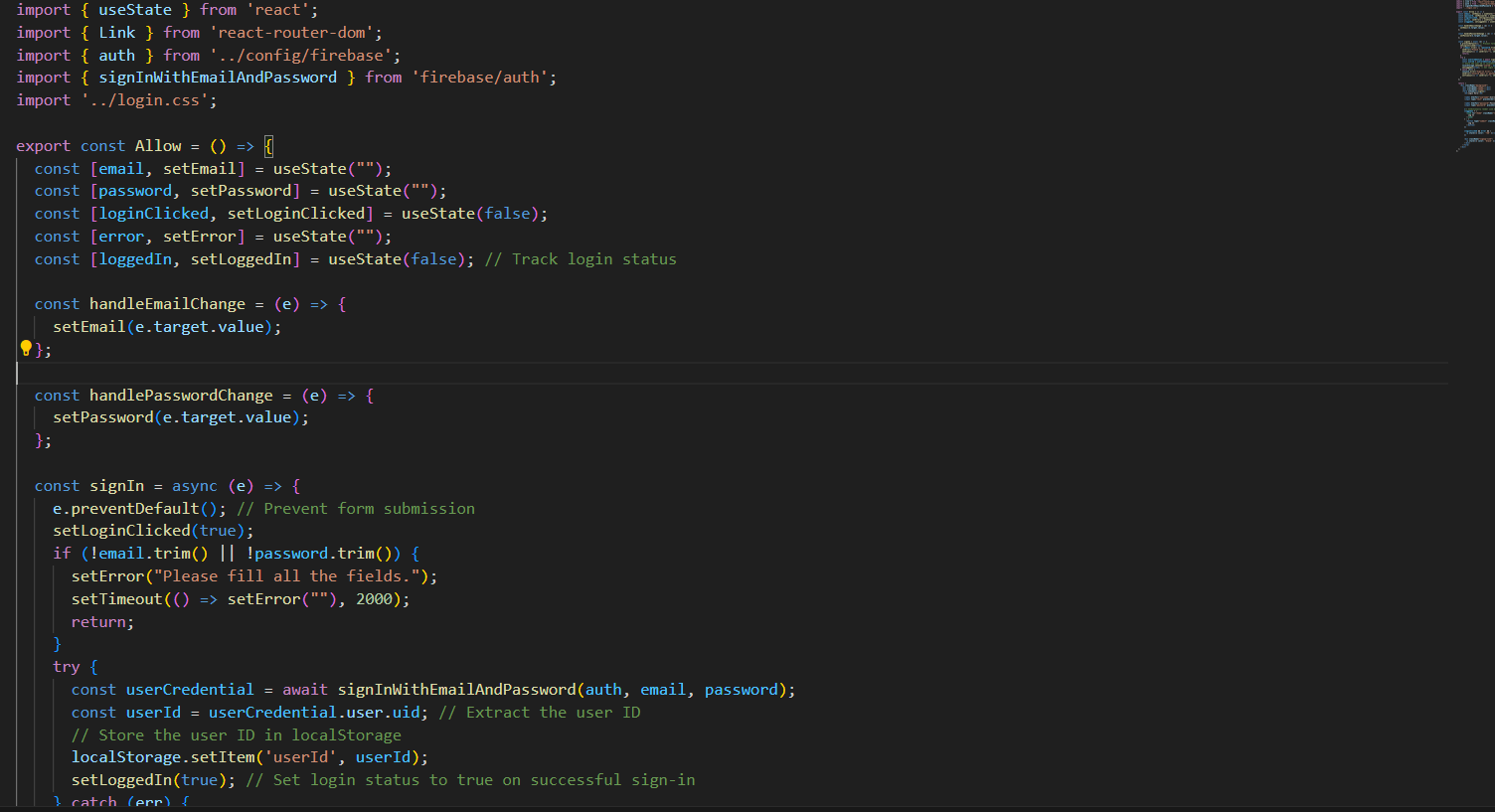

Slide 42
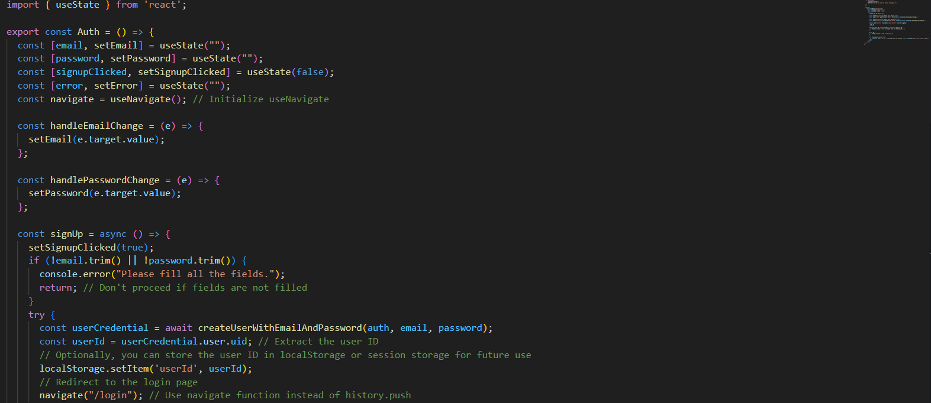

Slide 43
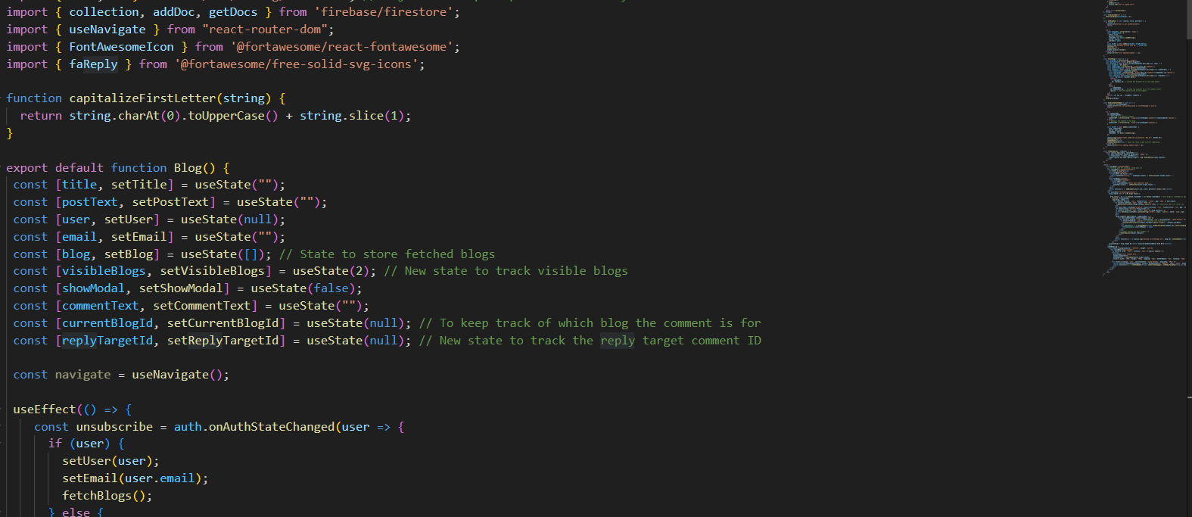

Slide 44


Slide 45
FUTURE ENHANCEMENT
Assignment Review: Implement a peer review system where users can submit assignments or projects for review by their peers, providing feedback and learning from each other.
Virtual Classroom: Introduce a virtual classroom feature with live video lectures, interactive whiteboards, and chat functionality to simulate a traditional classroom environment.
Advanced User Leaderboards: Create leaderboards based on specific language skills, such as vocabulary, grammar, listening, or speaking. Users can compete with others in these skill areas, motivating them to improve in specific areas of language learning.
AI Generated Questions:In the future, we plan to incorporate AI-generated questions to enhance user engagement and provide more personalized and adaptive learning experiences.
Admin Page: Admin can access the user list and their score.

Slide 46
CONCLUSION
Our research provides practical solutions to enhance online language learning by improving interaction and collaboration tools.
Our project aims to revolutionize coding language learning with a user-centric platform featuring language selection, progress tracking, quizzes, and a personalized learning journey.
The system's accessibility promotes flexibility, and regular updates ensure it stays
relevant and adaptable.
By addressing these challenges, we contribute to the ongoing evolution of online education and empower learners worldwide

Slide 47
REFERENCES
M. H. Long, “The role of the linguistic environment in second language acquisition,” in Handbook of Research on Language Acquisition, vol.2: Second language acquisition,
W. C. Ritchie and T. K. Bhatia Eds., New York: Academic Press, 1996, pp. 413-468
C. Dreyer, N. Bamgeni, and C. Nel, “A framework for supporting students studying English via a mixed-mode delivery system,” In Distance Education and Languages, B. Holmberg, M. Shelley and C. White Eds., Clevedon: Multilingual Matters LTD, 2005, pp. 92-118.
Li WJ, Yen C, Lin YS, Tung SC, Huang S. JustIoT Internet of Things based on the Firebase real-time database. In2018 IEEE International Conference on Smart Manufacturing, Industrial & Logistics Engineering (SMILE) 2018 Feb 8 (pp. 43-47). IEEE. [2]

Slide 48

THANKYOU

